Slide 1

Economics & Business

Slide 2
Economics & Business
Lesson 9 - Government Involvement in the Market

Slide 3
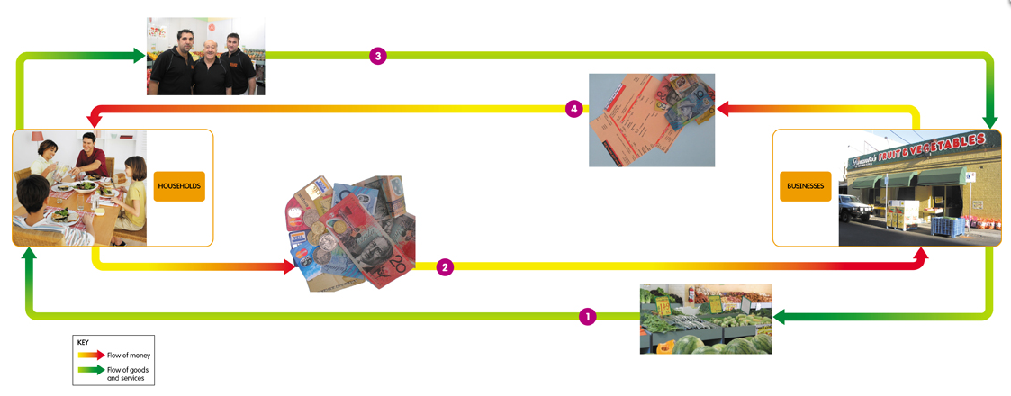
This model shows the relationship between the sectors

Slide 4

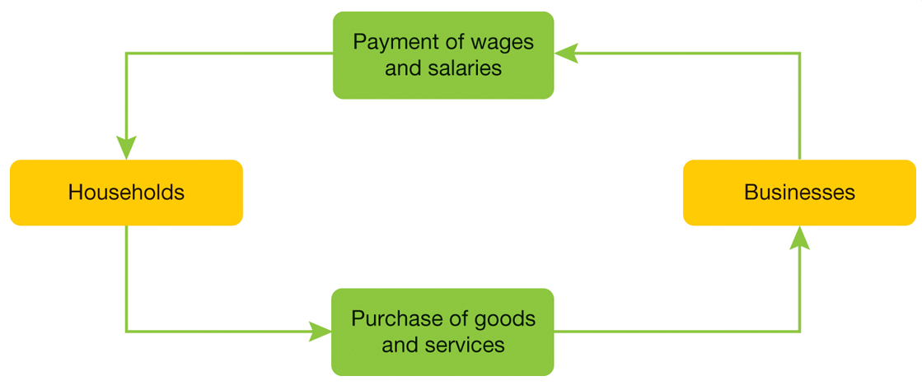

Slide 5



Financial
Sector
Financial intermediaries, such as banks and credit unions, make up what we sometimes call the financial sector of the economy.

Slide 6
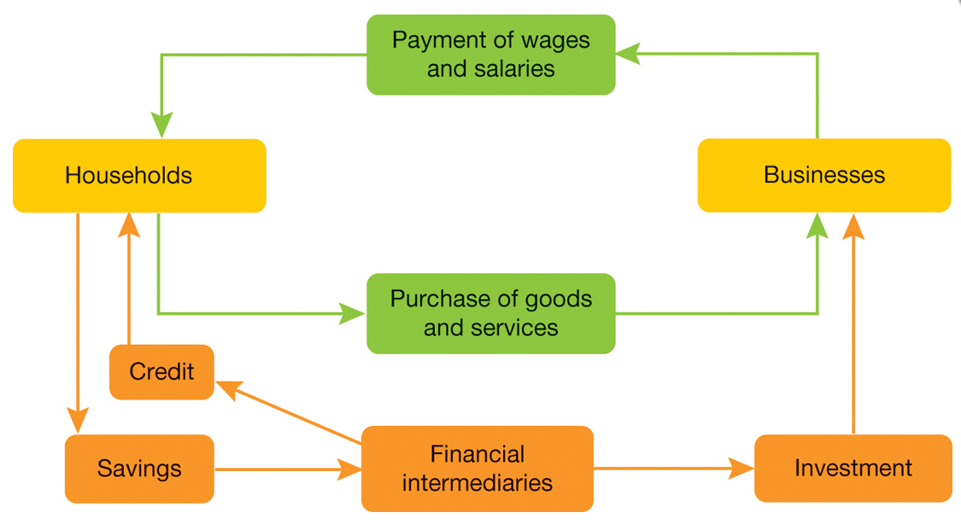

Slide 7


Government
Sector

Slide 8
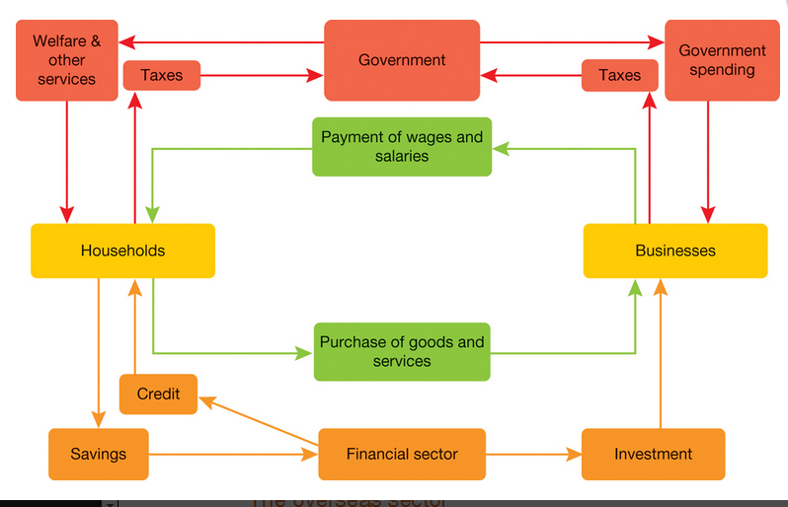

Slide 9

Politicians, commentators and the media often refer to the issue of ‘economic management’ as a responsibility of government.

Slide 10

The government will take action to encourage growth in the economy and to avoid high levels of unemployment. Government activity within a market economy goes well beyond this.

Slide 11
The government is involved in the market in the following areas:
Law and justice
Welfare
Infrastructure
Goods & Services
Environment

Slide 12


Draw a topic wheel to fill the A3 page:
Welfare
Law and justice
Infrastructure
Goods & Services
Environment

Slide 13

Week 4 - Lesson 9
www.misslowrieyear8.com
Scan and skim the relevant sections and take notes in the topic wheel.

Slide 14

How can government welfare payments have an impact on the market for goods and services?
Why might it be important for government to be involved in the regulation of wages and working conditions for employees?
What effect might environmental laws have on the costs experienced by businesses in managing waste from their production processes?

Slide 15



Classwork

